Slide 1

iOS Dev Scout Singapore, October 2018
Notes:
Hello everyone. Welcome to iOS dev scout October 2018.
In my presentation today, I would like to introduce to you one way that can potentially raise up the product revenue. And it means you will have more bonus, your family will be more happy. Just kidding.
Before we start, I wanna briefly introduce about myself.

Slide 2

Thanh
Software Engineer
Rakuten Viki
linkedin.com/in/thanhturin/
thanhturin@gmail.com
Notes:
My name is Thanh
I’m currently an iOS developer at Rakuten Viki, an Asian Drama Streaming Platform.
Once again, thanks Lizzie for her recent introduction.
You can find more information about me by visit my home page on linkedin.
And if you have any question or anything unclear about my talk, please don’t hesitate to send a message to my email thanhturin@gmail.com

Slide 3









“People who are really serious about software should make their own hardware”
Alan Kay
Notes:
I think most of us here are iOS developers and I guess you are very familiar with Apple eco system (if don’t wanna say you are all experts)
We are using Apple products everyday
We use Macbook for working
We use Apple Watch for tracking our fitness, health
iPhone for communication and entertainment
I don’t know your feeling about Apple products but I really love it.
The truth is I have not seen any iOS developers use Android phone but I saw many Android developers around me are using iPhone
Even they work for the rival with iOS, they still decide to use it.
So what does it mean? It means Apple has built a successful eco system.
Today I wanna talk about one of the child in Apple family, this is a hardware device, which come with a private operating system for it
This is a device looks like a mac mini, but runs on an operating system very close to iOS
The device I’m mentioning is Apple TV
And my topic today is “Developing for Apple TV”

Slide 4
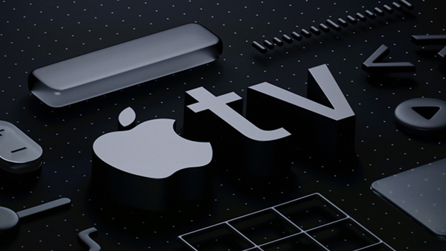
Developing For Apple TV
Notes:
Why do we should implement Apple TV app:
First, Apple users always spend more than other platforms users.
It makes sense because usually Apple devices are more expensive
And people who adapt to buy it for entertainment are very potential to pay for our service...
Show how grows it is on number of Apple TV sold…
From 5m in 2012 to 25m in 2015 and 75m in 2017
More and more support, better device, better user experiences…
User feedback about experience while using tv app compare with phone app
Last but not least, It does not cost much to keep building and maintaining tvOS app. You wanna see how easy is it. I will show you right now.

Slide 5

Agenda
Apple TV and tvOS
Developing for Apple TV
Demo
Notes:
Agenda today I will break my talk into 3 separate sections
First, I will briefly introduce about Apple TV and tvOS
Then I will talk about fundamental thing when building Apple TV App
After all, I will show you how to do it in a real demo
After than I will give you a demo of building a small app which supports for both iOS and tvOS
And finally I will try to implement with you a small feature to enhance how easy it is to maintain the app

Slide 6
Apple TV & tvOS
Notes:
SO okay. let’s quick start with Apple TV and tvOS introduction

Slide 7
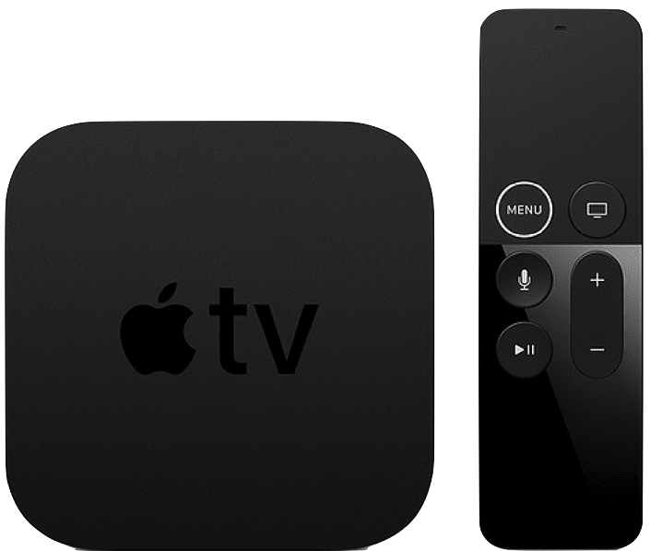
Apple TV 4K
5th Gen (2017)
Notes:
Apple TV is a digital media player device. It can collect data from internet by Wifi. And to use it for viewing, you have to connect it to a TV by a HDMI cable. Apple TV, as I introduced before, runs on tvOS, and the latest tvOS is tvOS 12.
On the screen is the latest Apple TV release, Apple TV 4K, the 5th gen.
As you can see it has no integrated controls, therefore it can only be interacted externally. Apple provides several ways to communicate with Apple TV.
By default, when you buy an Apple TV, inside the box, there will be a controller. And it will use Bluetooth to compare with Apple TV.
Apple name it Siri Remote because you can use your voice to control Apple TV by Siri assistance
Furthermore you also can use your iPhone to control Apple TV. This is something very awesome from Apple. Everything can be compatible perfectly
If you have not tried it before. we are putting some Apple TV, as well as Android TV and Roku TV on the back shelf. If you are interested, you can go there give it a try
It was launched last year. For CPU, It’s using Apple A10 and the price for highest specs is about 300 SGD

Slide 8
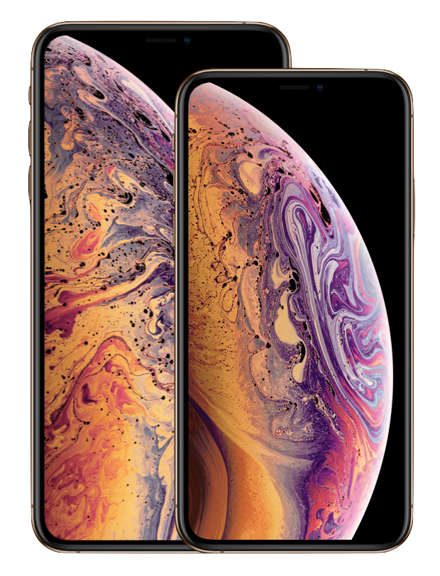
Notes:
So right now the latest Apple TV is the 5th generation, meanwhile the latest iPhone is XS, which one do you think is older than the other one, Apple TV or iPhone?

Slide 9

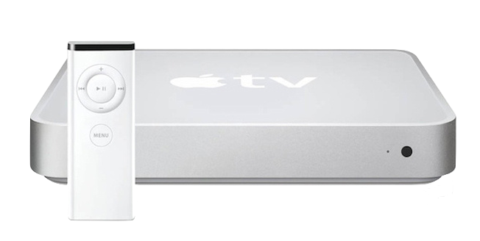
2007: iPhone 1st Gen
2006: Apple TV 1st Gen
Notes:
The first iPhone was introduced in the historical Apple Event 2007 by Steve Jobs, and it changed the phone industry forever
But do you know one year before it, Apple also announce another new device.
This is the Apple TV 1st Gen
But at this time, they have a different name for it
Here I have a gift for you if you can guess the correct name for it (iTV)
I give u a suggestion, but then you have to share the gift to me, the name has a similar concept with other devices from Apple such as iPhone, iPod, iPad, …
As you can see on the screen, the iTV box looks very close to the Mac Mini
And it also runs on MacOS X which make me fell like this is another version of Mac mini
Except it has the controller and can not connect to keyboard or mouse
CPU: Intel Pentium

Slide 10
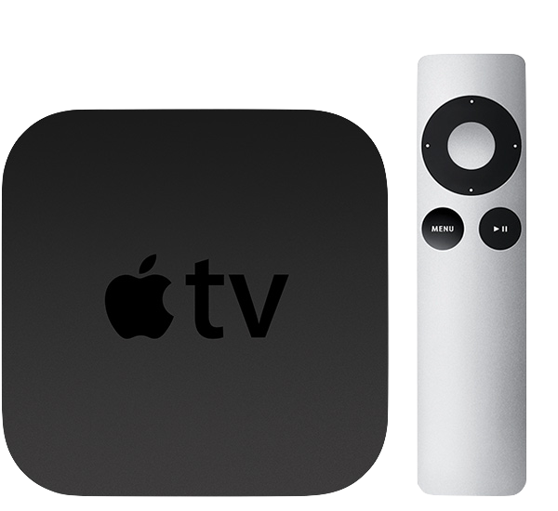
Apple TV 2nd Gen (2010)
Notes:
It takes 4 years to have the second generation of Apple TV
After the success of the first iPhone, Apple focused 100% on enhancing iOS eco system
They push iPod and iPad to run on iOS
And 4 years since the first announcement
In 2010 Apple redesign iTV and this is a huge refactoring.
They make a completely new appearance for iTV
From this version, Apple decided to use the name Apple TV instead of iTV as previously
It does not run on Mac OS anymore, and instead, it runs on iOS
Yes I emphasize again, it's iOS, Until end of 2010 Apple bring in tvOS 9 which is 95% bases on iOS 9
And since there afterward, Apple TV can only run on tvOS

Slide 11
Apple TV sold
Notes:
Here I have a chart for Apple TV turnover from 2012 to 2017. We can see one thing from it, Apple TV is growing up significantly.
In 2012, there are 4.2 millions devices has been sold, only three years later, the number has increased six time, to 25 million, and take another two year to reach 75 million, three times better.
75 millions is a huge number because Apple TV is a shared device, unlike iPhone is individual. So usually we only one Apple TV per family.
Easy for imagining, Apple TV is now taking 18% of the whole world TV box market, which is the second largest brand in the world
To make it easier to imagine, there are 1.2b iPhone + … meanwhile only have 75m Apple TV in end of 2017. (quite humble?)
(1.2b iPhone + 0.3b iPad + 0.5b iPod)
In 2016 there are 8k apps for tvOS (2k is game)

Slide 12
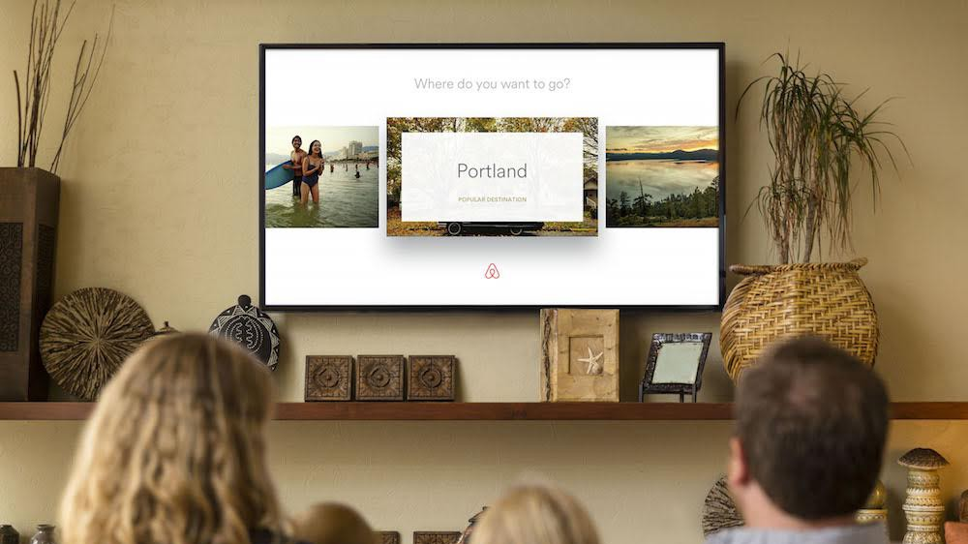
Notes:
Initially i thought apple tv is only applicable with Video and Game app. But i was wrong.
But I was wrong. There are many kind of apps on Apple TV further than that.
Do u think you can book your hotel room on apple tv
The answer is, yes, you can. Airbnb has an app on apple tv

Slide 13
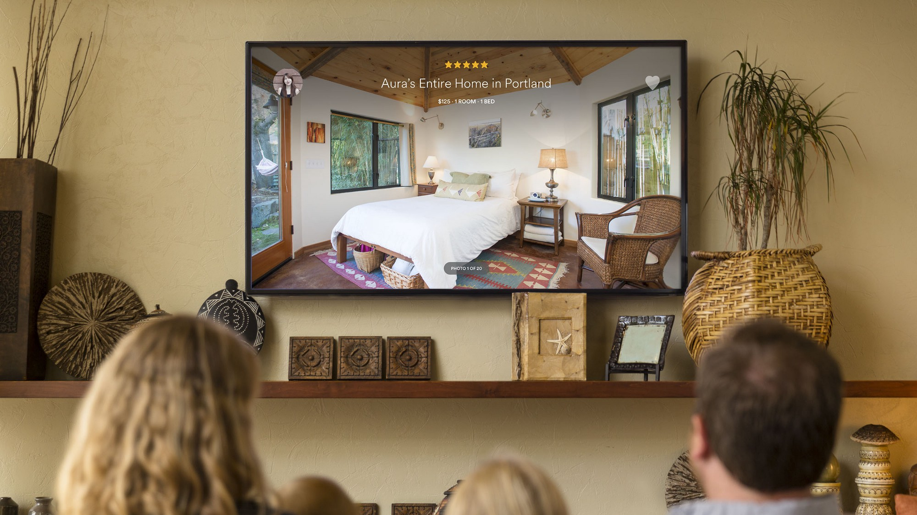
Notes:
Actually in some situations, Apple tv is a better choice than iphone,
Imaging you are planning for a vacation with your family.
Better if you guys can book the hotel together.
And apple tv is absolutely a better choice for your discussion because every one can see the room on a big screen.
And the big image, on the other hand, is more attractive and make you more desire to book the room.
Compare with their rival which does not have app on TV, they are losing this huge number of users

Slide 14
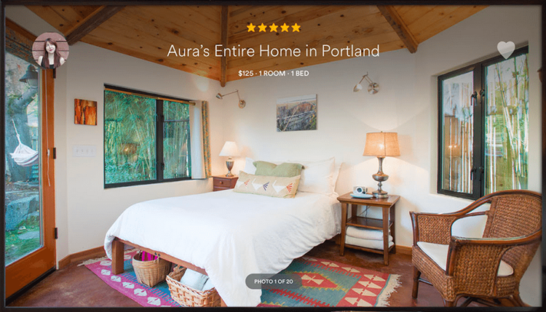
Notes:
This is an app about Flight, Weather Forecast, Dropbox, AMAZON, TINDER
In my perspective creativity has no limits. As long as you intend to do it, You will find a way to implement it
Enhecingly, as you can see on the chart not so long time ago, Apple TV is growing up very fast. And Apple team keep improving the experience on Apple TV, better device, better tvOS.
Just Keep in your mind that, user who willingly spend money to buy Apple TV for entertainment is very potential to pay for your service.
Also there are not much app on Apple TV now, just around 8k, and you can be easily featured by Apple.
And the cost to building and maintaing an app on Apple TV is not much. Especially if you already have one on iOS.
Last but not least, It does not cost much to keep building and maintaining tvOS app. You wanna see how easy is it. I will show you right now.

Slide 15
tvOS app
Custom app
Using same frameworks with native iOS
Client – Server app
Using TVML, TVJS, TVMLKit
Notes:
There are 2 types of Apple TV app. In general, we will make them in different way.
First is the custom app which you develop it similarly when we do on iOS. It use the same frameworks and concept that you already know. For example Storyboards, UIKit, Auto Layout, etc
The other one is client-server app, which you need to use TVML, TVJS and TVMLKit to make it. I will explain to you these 3 abbreviation

Slide 16
TVML
TVML (Television Markup Language) is a form of XML
Apple provides dozens of TVML premade templates
TVJS (Television JavaScript) is a set of JavaScript APIs which provide the means to display apps created by TVML
TVMLKit is a framework which will bridge the gap between native code and TVML, Javascript code.
Notes:
Apple provides dozens of TVML premade templates which is designed to help you can easily display information in a specific way. In a Few slides later I will show you some example of a TVML template
TVMLKit a framework that make you be able to communicate between TVML, JavaScript, and your native tvOS app
By using TVMLKit to can get any item on the screen, such as View or ViewController by element id and can override the implementation of it.

Slide 17
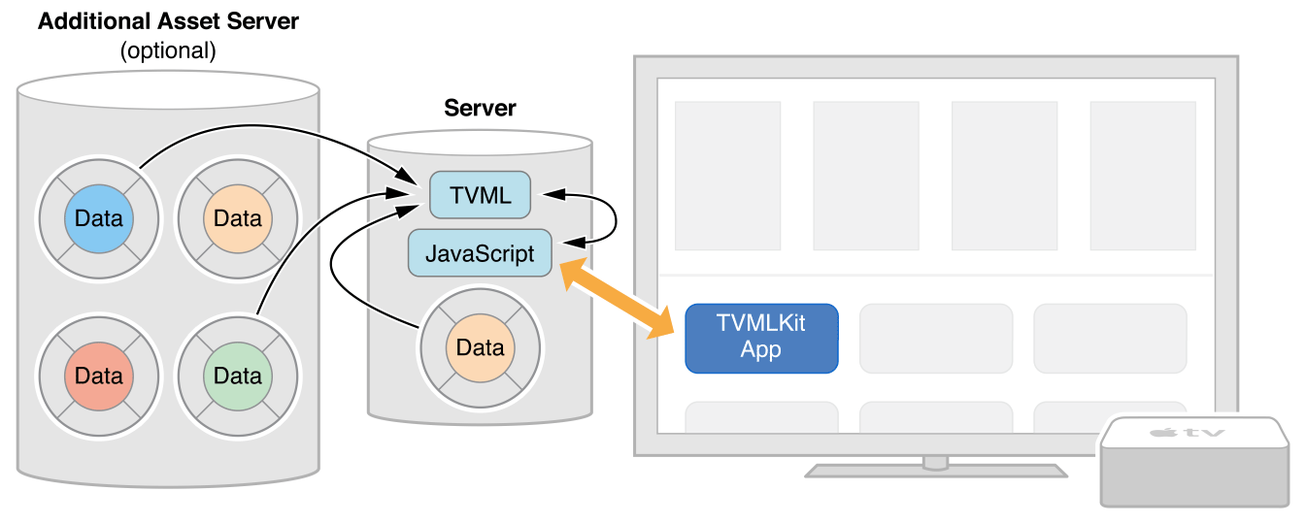
HOW DOES IT WORK?
Notes:
In short, for custom app, we just archive UI and logic code in the execution binary file.
Whereas, TVML app has different concept since the UI and logic code is on a remote server.
Our app is here, and we will put UI and logic code here.
We only declare the URL to that server in AppDelegate, and hence when the app launch, we will fetch the source code and lean on it to run the app.
Similarly with custom app, It may need to call other APIs to get data from server when user using the app

Slide 18
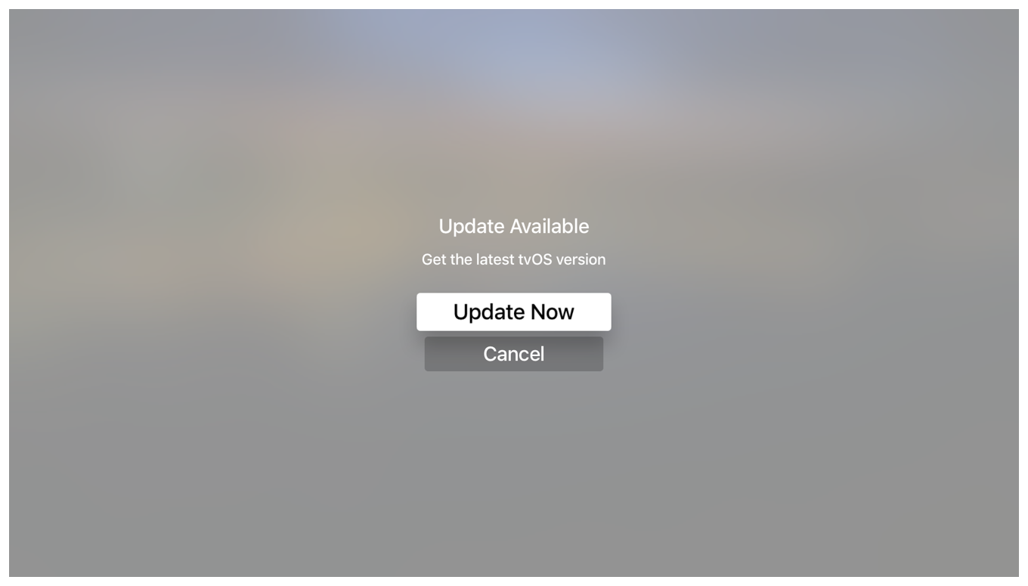
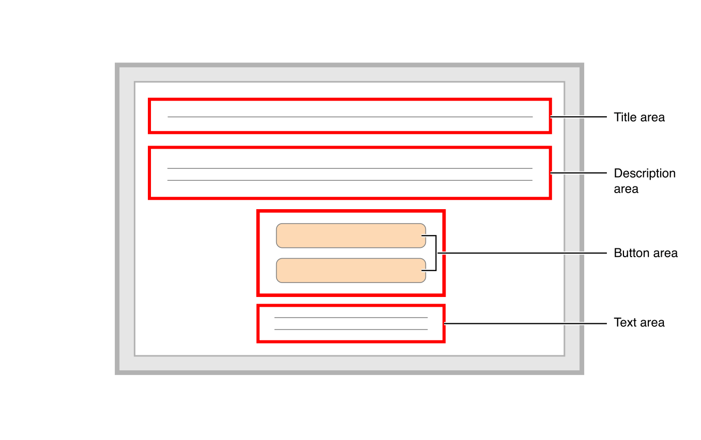
TVML Template Example
Notes:
We will continue with some TVML premade template example.
So I will start with a simple one first
On your left hand side is the alert view on Apple TV
On your right hand side is the premade template diagram
It’s not so hard to link each element from the diagram to the view
For instance, Title area will be the first line, and follow by description, and buttons, etc

Slide 19
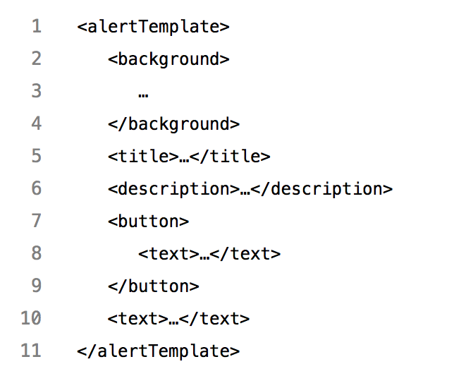
TVML Template Example
Notes:
And this is is how the template code look like
If you know any markup language such as XML, HTML before you would be familiar this format
The biggest field is alertTemplate, it has some properties, like background, title, description, etc. And they will represent for the element on the diagram

Slide 20
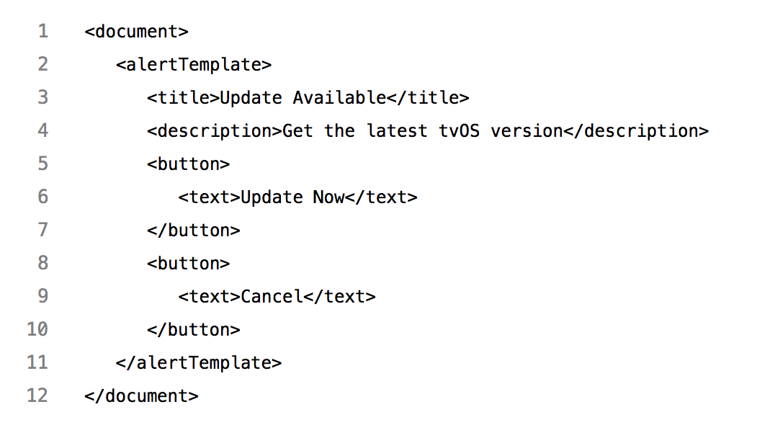
TVML Template Example
Notes:
And finally after filling data to the template you will get the view as expectation
Like here i put "Update available" for title field,
"Get the latest tvOS version" for description field, …
Then when the app run, it can convert from template to the native view on the screen
I just wanna highlight, It is not a web view, but a native components
This is a very simple one.
But as i mention above, there are a lot of premade templates from Apple.

Slide 21
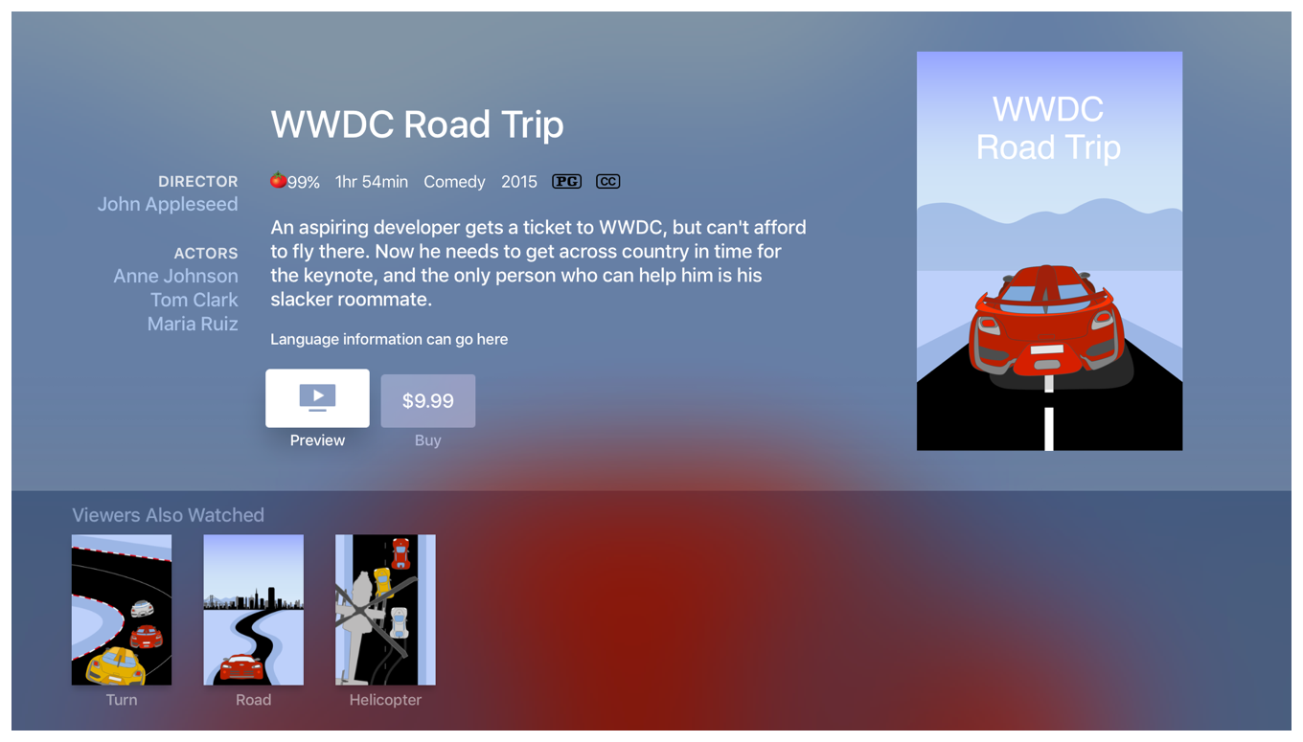
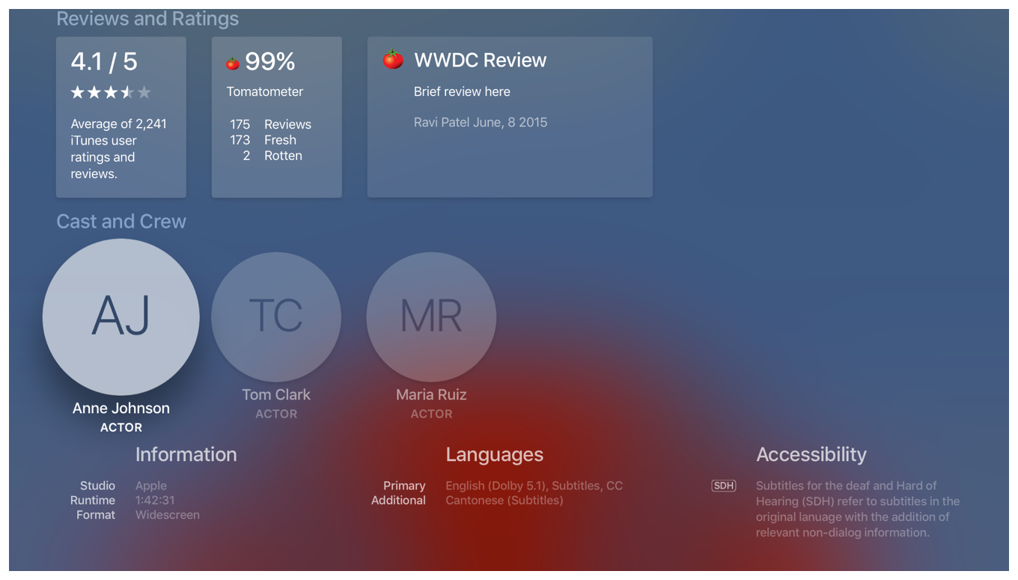
TVML Complicated Template
Notes:
Let’s look at this.
This is a long page.
I slip it into 2 images
The left one is the front, and the right one is the back
It has a very complicated layout and imagine how much it will cost you to implement on custom app
You will need to care about a lot of layout constraints, collectionview data source, and the shadow and blur background here you also need to handle it thoroughly
On the other hand, TVML has a template for this page

Slide 22
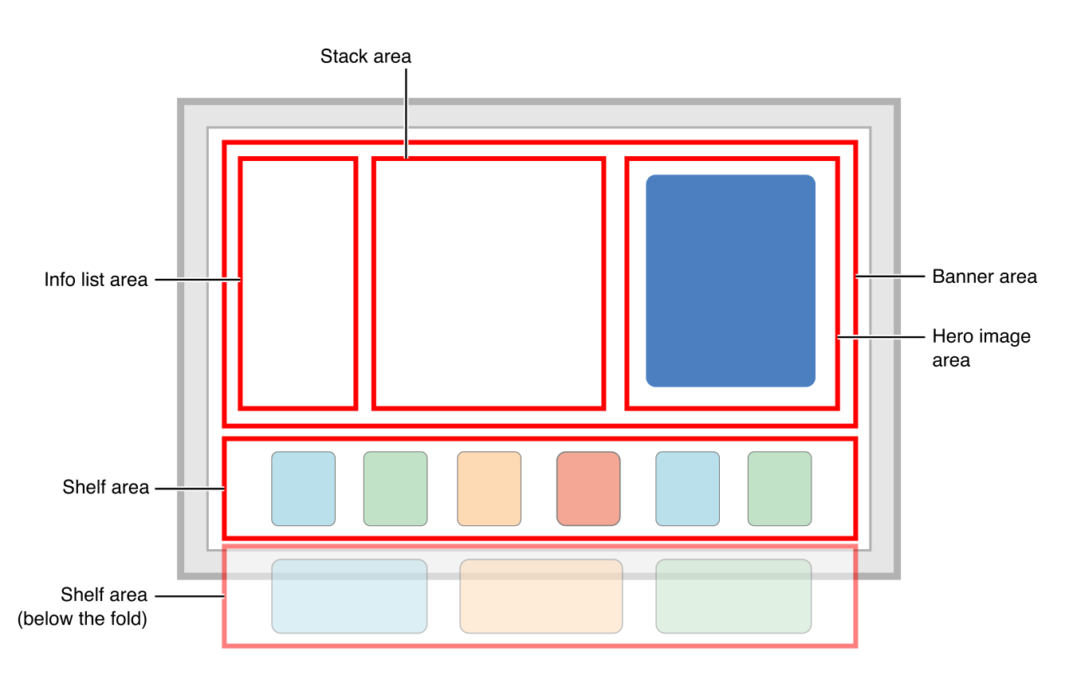
Notes:
And this is how it look like. Very specific and easy to understand
Like here is the banner area, within it will have Info list, stack view and an image.
Following by some shelf area

Slide 23
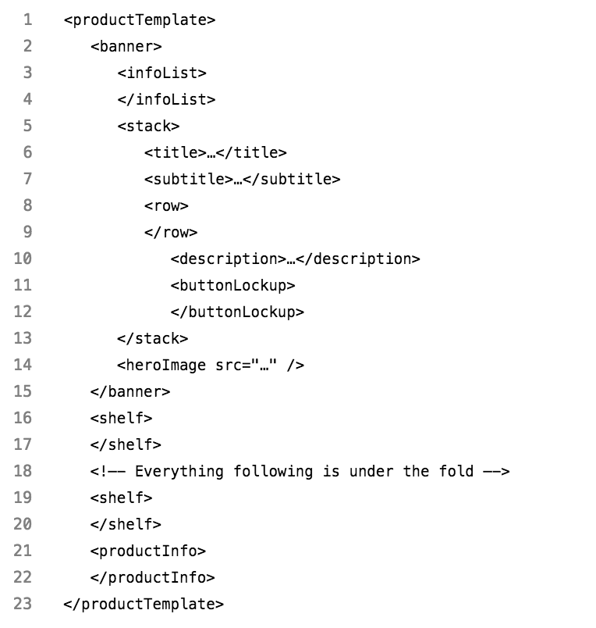
TVML Complicated Template
Notes:
So here is the template code
You can easily map it with the diagram
We can base on the template to key in our data we wanna display, and TVJS can generate the view for you automatically.
Very simple, and save you lots of time
You can find more on Apple documentations page

Slide 24
COMPARISON
Custom App | TVML App
Same way with iOS native app | TVML, TVJS, TVMLKit
Swift, Objective-C | JavaScript
More effort but scalable | Less effort but not scalable
Suitable with customizing layout | Suitable with Apple template layout
Notes:
So I make a comparison between working on custom app versus on TVML app
We develop custom app by the same way we do on iOS, meanwhile on TVML we use TVML, …
The main language when working with custom app is swift and objective c, whereas on TVML it will be JavaScript
The custom app will take you more effort for creating, but it is scalable in long term and this could be your choice if your app have customizing design,
On the other hand creating TVML app cost you less effort at the beginning, but it is not scalable and only appropriate with the app has similar design with Apple template layout
So depends on your purpose you can find a most suitable way to implement your tvOS app.
But for us here in Viki, we have implemented our Apple TV app in both ways. And with the experience we have, I would recommend you to make a custom app instead. Because
First
We already have an iOS project which has a lot of same feature with Apple TV app
By using custom app we can reuse a lot of logic code, and it make us can maintain and scale both app together
And this is what every business always want. We want our platform testable, maintainable, scalable
Second
And will take a lot of time to ramp up with TVML because it’s a new concept. And for those who have work with JavaScript before, it will be more time consuming to get used to it.

Slide 25

vs
Notes:
Honestly, I am much more comfortable to work on Swift than on JavaScript
On Swift and ObjC you can use break point when debugging and Fabric for tracking crash. On JavaScript you don’t have it, all of the crash from TVML will just come through App Delegate, not easy for us to fix the crash

Slide 26
Developing Custom Apple TV App On iOS Project

Slide 27
Project structure
UI
User Interface, User Action Handler
Business Logic
API Service, Deep Link, Analytics, Calculation, etc
Third Party Libraries
Install from CocoaPods, Carthage or import Framework directly
Core Framework
Foundation, UIKit, CoreData, etc
Notes:
For any project, we can basically split it into 4 different layers
At the bottom is Core framework such as Foundation, UIKit, CoreData, CoreLocation, …
They are very fundamental and general.
Then we need to use some 3rd party libraries which is built on top of Core Framework for more specific purpose.
You can install them from Cocoa Pod, Carthage, or download and add the framework sdk directly
These two first layers are very basic and available for all the app. We use them as the ingredient to make our app
The next layer is business logic.
This layer contains some services like API Service to communicate with server, or Payment Service, or Location Service, etc.
Beside that it also has deep link handler to deal with Push Notification or to support universal link
Analytics logger for tracking data
And some calculation if needed…
In reality, you can device business logic to smaller layer. It’s up to the design pattern you choose
The top one is UI layer.
It is responsible to display the app content to user
As well as to receive user action
And ask logic layer for data or for some calculation and depends on the result to response back to user
Our aim is to build up Apple TV app with the least cost. Assuming we already have an iOS app, so we will try to reuse the source as much as possible, and avoid to repeating the code. Look at the diagram, let’s see what we can take advantage on tvOS

Slide 28
Reusability
UI
Very little, Only for base classes
Business Logic
Most of them, as well as the feature is adaptable on the device
Authentication logic, Payment logic, API Service logic, etc
Third Party Libraries
Most of them, except libraries from unsupported framework
Including RxSwift, Alamofire, SwiftyJSON, Crashlytics, etc
Core Framework
Most of them unless the device does not support
WebKit, BiometricKit on iOS <> TVUIKit, TVServices on tvOS
Notes:
Core Framework
Most of the frameworks on iOS is also available on tvOS, like Foundation, UIKit, etc
But for some reason, there still be some frameworks only available on iOS
For example, BiometricKit is not on tvOS, because it does not have TouchId or FaceId for authentication purpose. Hopefully they can integrate it to Siri Remote in a near future
WebKit is another one not on tvOS because Apple TV does not use WebView.
In contrast, tvOS also have some framework does not support iOS, like TVUIKit and TVSerives. It contains some UI elements and services specifically design for Apple TV
Third Party Libraries
Because 3rd party libs is built on top of Core Framework. So most of the libraries on iOS will support for tvOS as well. Such as RxSwift, Alamofire or AFNetworking, SwiftyJSON, … support for tvOS as well
Business Logic
When we plan to implement a feature, we always want to do it for both iOS and tvOS, as long as the device is adaptable with the feature.
Ideally for those feature, all of the logic code must be shared between 2 platforms
Sharing code will make our project maintainable and scalable
UI
Because of the difference between iOS devices and Apple TV, the layout on iOS and tvOS is different. So basically we will not reuse much UI code. We may only be able to reuse some base UI Class extension from UILabel, UIButton, …
So to summarize, as long as we separate UI code and Logic code, we don’t need to do many things to have Apple TV app.
Morever, Isolating Logic code to UI code not only make your project more organized but also make it more testable. So I really encourage you to split them out.
I have talk about it too much. Let’s start with a Demo. I will show you in reality.

Slide 29
Demo

Slide 30
Notes

Slide 31
Fastlane
Fastlane is not supporting tvOS officially
Using platform tvos to define lane
Notes:
@default = [:ios, :mac, :android]
https://github.com/fastlane/fastlane/blob/master/fastlane/lib/fastlane/supported_platforms.rb

Slide 32
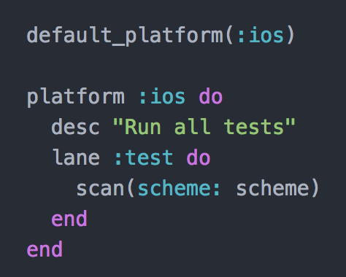

Slide 33
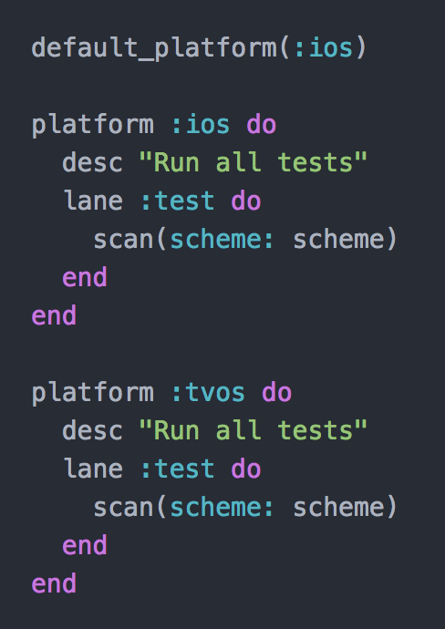

Slide 34
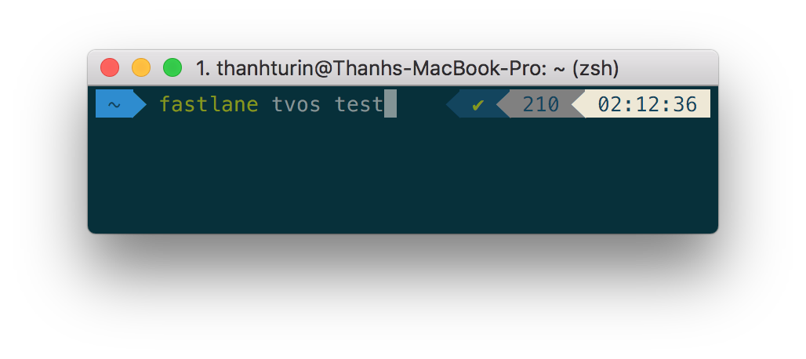


Run fastlane

Slide 35
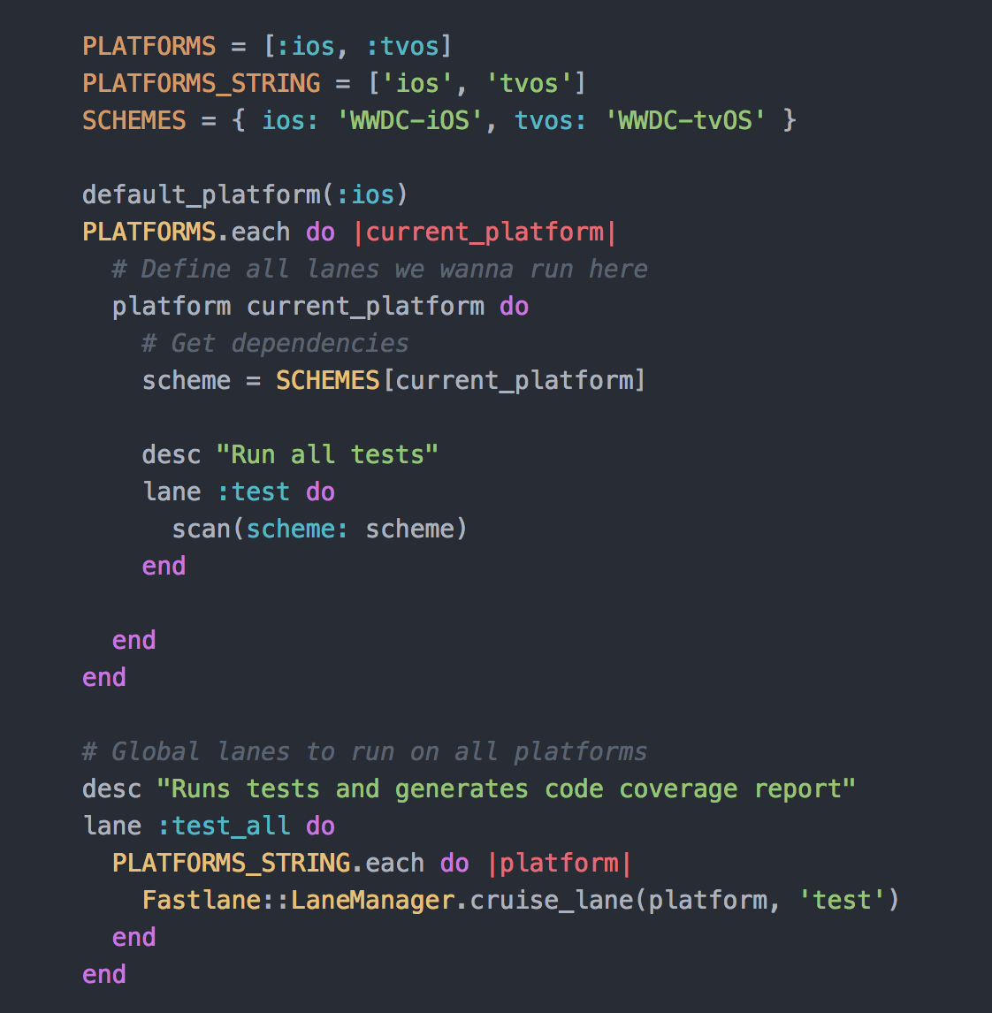

Slide 36
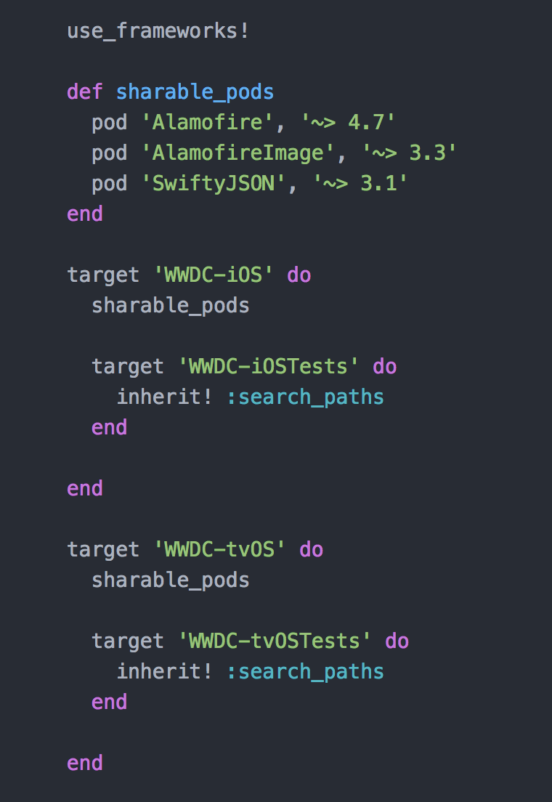
Cocoa pod

Slide 37
Q&A

Slide 38
Thanks for your attention

